Slide 1
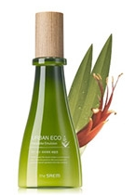
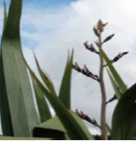

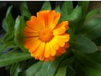
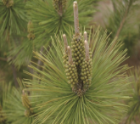
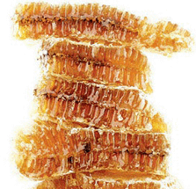

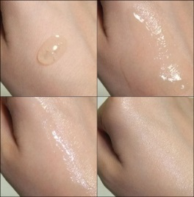
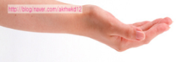
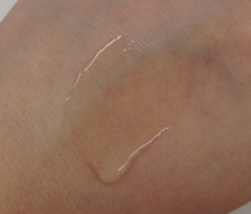
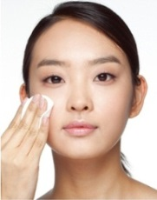
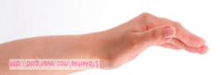
‘Pure and Moist-full Energy’
Urban Eco Harakeke Fresh Toner
Name | Urban Eco Harakeke Fresh Toner [180ml/13,900 won]
Target | Those who wants fresher texture/ Oilier skin type Harakeke user Men who’s looking for gentler toner
Feature
Sales Talk | 1. Partner with Harakeke Fresh Cream! Are you looking for fresh type toner? Our best selling line, Harakeke, now has fresher type toner with skin clarifying effect for oilier skin or humid or hot season. Refine and clarify you skin and finish up with Harakeke Fresh Cream. Harakeke line will capture and retain every moisture in your skin. 2. Introduce it to Male Customers ! If you want a mild and moisturizing toner, try this refreshing and mild toner made with 92% Harakeke Gel. Harakeke’s amazing moisturizing effect and Pine Tree Sprout’s clarifying effect will keep your skin pure, fresh and moist everyday.
Direction | After cleansing, pour generous amount of the Fresh toner onto a cotton pad, wipe out in outward direction.
New, Fresher type Toner is now Launched.
92% Harakeke gel containing toner is now available in fresher texture to offer skin clarifying function as well as supplying moisture
Skin purifying, Moist Capturing Toner
Moisturizing
100% Harakeke extract in place of water
Also contains Harakeke seed oil to enhance moist-restoring capacity.
100% Harakeke gel used in place of water
- Immediate moisture restoring right after cleansing.
- Holds every moisture within the skin.
Eco Cert certified Calendula water, New Zealand Manuka Honey to add more nutrients
Skin Clarifying Effect by Pine Tree Sprout
- Astringent effect
- Removes impurities and dead surface cells.
- Texture becomes smoother and supple.
6 Free system
No alcohol, Paraben, Talc, Mineral oil, Benzophenon, animal oil
Moisture capture
Texture refining
Calendula Flower water
Manuka Honey –
(Exclusive contract with Living Nature)
Pine Tree Sprout
Soothing and clarifying
Phytoncide Effect
Helps regulate turn over cycle
Harakeke toner VS Harakeke Fresh Toner
Harakeke toner | Harakeke Fresh Toner
92% Harakeke gel | 92% Harakeke gel
Elastin Gel Texture | Watery texture ( Need to use with cotton pad in wipe-out motion.)
Deep Moisturizing | Clarifying & moisturizing
toner
Toner
피부 결 정돈

